Slide 1
Search Strategies Session 04
Course : COMP6065001 Artificial Intelligence
Effective Period : September 2023

Slide 2
Learning Outcomes
At the end of this session, students will be able to:
LO 1: Describe what is AI and identify concept of intelligent agent
LO 2: Explain various intelligent search algorithms to solve the problems

Slide 3
Outline
Problems Example
Searching Algorithms for Solutions
Uninformed Search Strategies
Informed Search Strategies
Exercise

Slide 4
Problem Solving Agents
Solving a problem can be simplified if the agent can adopt a goal and aim satisfying it
Goal Formulation
Is the first step in problem solving
Problem Formulation
Is the process of deciding what actions and states to consider

Slide 5
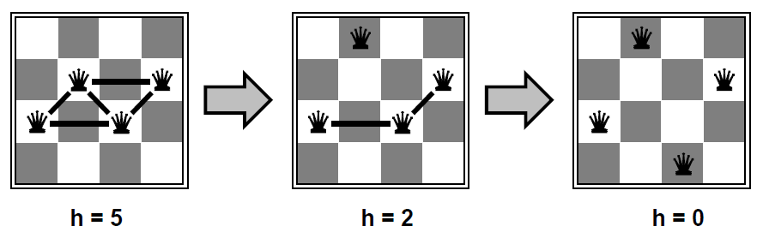
Example Problems
The 4-queen problem:
On a chess board, place 4 queens so that no queen is attacking each other

Slide 6
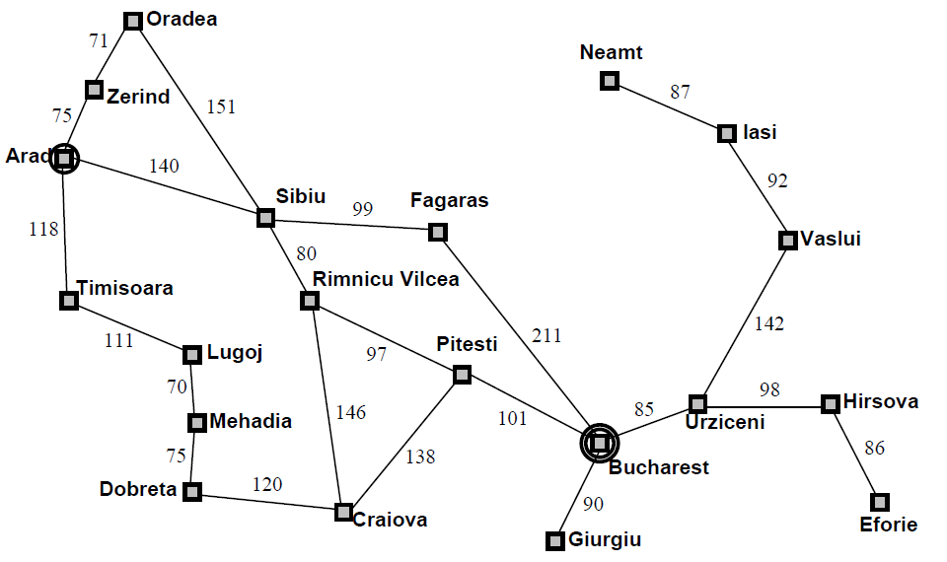
Example Problems
The path finding problem
Find a path from Arad to Bucharest

Slide 7
Problems Formulation
A problem can be defined formally by five components:
The initial state: The state where the agent starts
Actions: Possible actions available to the agents
Transition model: A description what an action does
Goal test: Check if a given state is a goal state
Path cost: Measure the cost to achieve the goal

Slide 8
Problem Formulation
The 4-queen problem:
The initial state: No queen on the board
Actions: Add a queen to any empty square
Transition model: Returns the board with a queen added to the specified square
Goal test: 4 queens on the board, none attacked

Slide 9
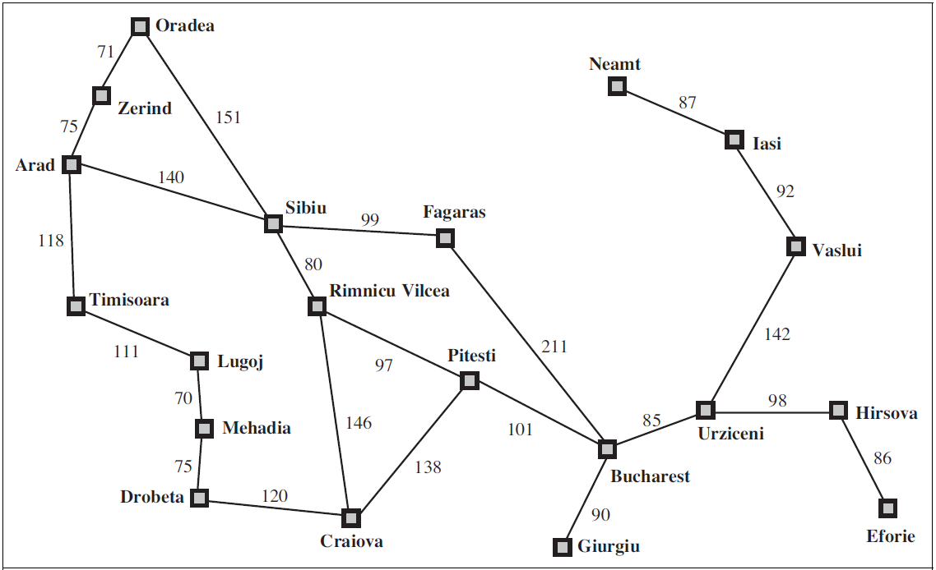
Problem Formulation
The path finding problem:
The initial state: In (Arad)
Actions: Go (Zerind), Go (Zibiu), etc
Transition model: Results (In (Arad), Go (Zerind)) = In(Zerind)
Goal test: In (Bucharest)
Path cost: Path length in kilometers

Slide 10
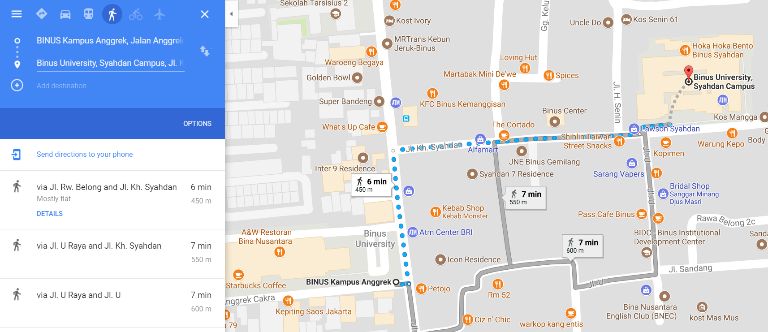
Example Problems (Real World)
Route finding problems

Slide 11
Searching for Solutions
Search tree: models the sequence of actions
Root: initial state
Branches: actions
Nodes: results from actions
Expanding:
Process of generating child nodes (performing an action)

Slide 12
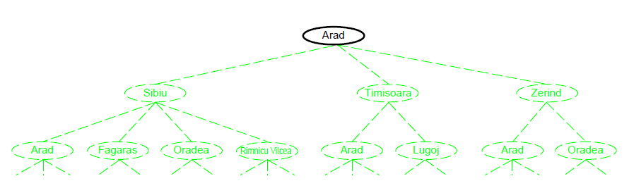
Searching for Solutions

Slide 13
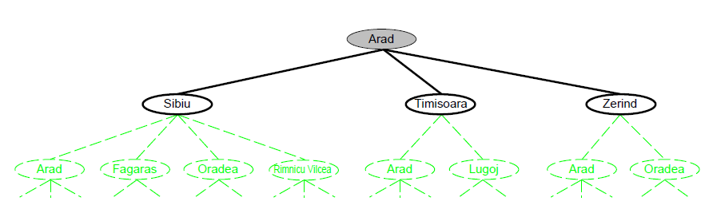
Searching for Solutions

Slide 14
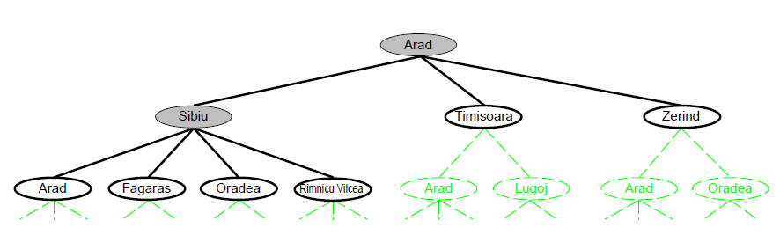
Searching for Solutions

Slide 15
Searching for Solutions
Leaf node
A node that has no children in the tree
Frontier
The set of all leaf nodes available for expansion at any given point
Explored set
The set of all expanded nodes

Slide 16
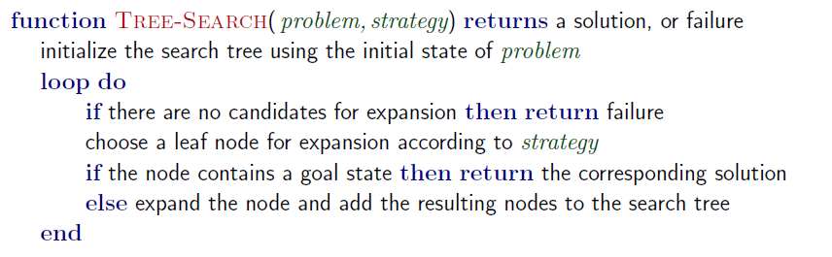
Tree Search Pseudocode

Slide 17
Searching for Solutions
Measuring problem-solving performance
Completeness: Is the algorithm guaranteed to find a solution when there is one?
Optimality: Does the strategy find the optimal solution?
Time complexity: How long does it take to find a solution?
Space complexity: How much memory is needed to perform the search?

Slide 18
Search Algorithms
There are two types of search algorithms
Un-informed search (Blind search)
No additional information/knowledge about states
Informed search (Heuristic search)
There is problem specific knowledge to help find the solution

Slide 19
Un-informed Search Strategies
Strategies:
Breadth-first search (BFS): Expand the shallowest node
Uniform-cost search (UCS): Expand the least cost node
Depth-first search (DFS): Expand deepest node
Depth-limited search (DLS): DFS with depth limit
Iterative-deepening search (IDS): DLS with increasing limit

Slide 20
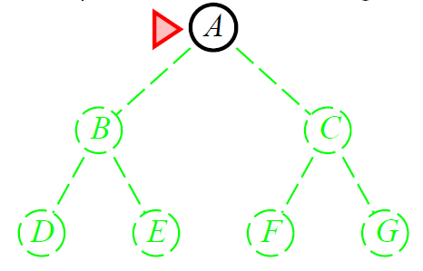
Breadth-first Search (BFS)
Expand shallowest unexpanded node
Implementation: a FIFO queue

Slide 21
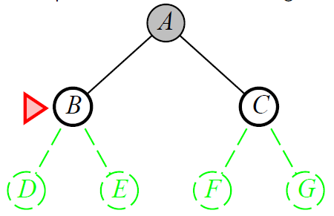
Breadth-first Search (BFS)
Expand shallowest unexpanded node
Implementation: a FIFO queue

Slide 22
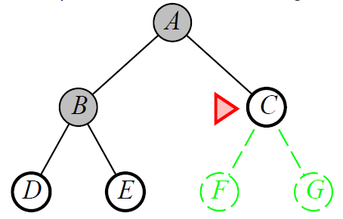
Breadth-first Search (BFS)
Expand shallowest unexpanded node
Implementation: a FIFO queue

Slide 23
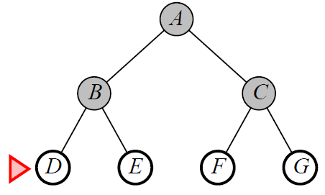
Breadth-first Search (BFS)
Expand shallowest unexpanded node
Implementation: a FIFO queue

Slide 24
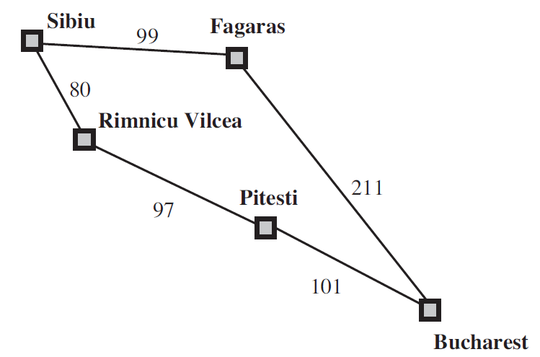
Uniform-cost Search (UCS)
Instead of expanding the shallowest node, it expands the node n with the lowest path cost g(n)
Instead of queue (FIFO), it utilize priority queue based on g(n)

Slide 25
Uniform-cost Search (UCS)
Sibiu
80
99
Rimnicu Vilcea
Fagaras

Slide 26
Uniform-cost Search (UCS)
Sibiu
80
99
Rimnicu Vilcea
Fagaras
80+97=177
Pitesti

Slide 27
Uniform-cost Search (UCS)
Sibiu
80
99
Rimnicu Vilcea
Fagaras
177
99+211=310
Pitesti
Bucharest

Slide 28
Uniform-cost Search (UCS)
Sibiu
80
99
Rimnicu Vilcea
Fagaras
177
310
Pitesti
Bucharest
101+177 = 278
Bucharest

Slide 29
Uniform-cost Search (UCS)
Sibiu
80
99
Rimnicu Vilcea
Fagaras
177
310
Pitesti
Bucharest
278
Bucharest

Slide 30
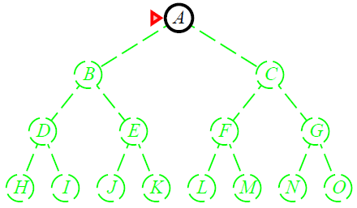
Depth-first Search (DFS)
Expand deepest unexpanded node
Implementation: a LIFO queue

Slide 31
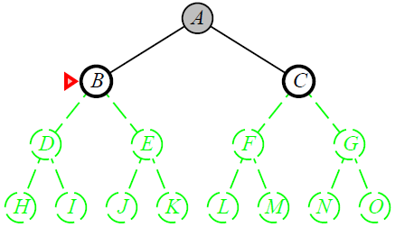
Depth-first Search (DFS)
Expand deepest unexpanded node
Implementation: a LIFO queue

Slide 32
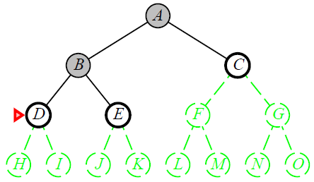
Depth-first Search (DFS)
Expand deepest unexpanded node
Implementation: a LIFO queue

Slide 33
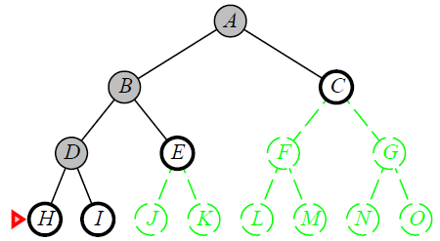
Depth-first Search (DFS)
Expand deepest unexpanded node
Implementation: a LIFO queue

Slide 34
Depth-limited Search (DLS)
DFS with depth limit l (nodes at level l has no successors)
It solves the infinite-path problem
Sometimes, depth limits can be based on knowledge of the problem
For example, on the map of Romania, there are 20 cities
And if we study the map carefully, we could discover that any city can be reached from an other city in at most 9 steps (l)

Slide 35
Iterative Deepening Search (IDS)
Combine the benefits of BFS and DFS
The memory requirements are small like DFS
It is complete and optimal like BFS (when condition applies)
Idea: Iteratively increase the search limit until the depth of the shallowest solution d is reached
Applies DLS with increasing limits

Slide 36

Iterative Deepening Search (IDS)

Slide 37
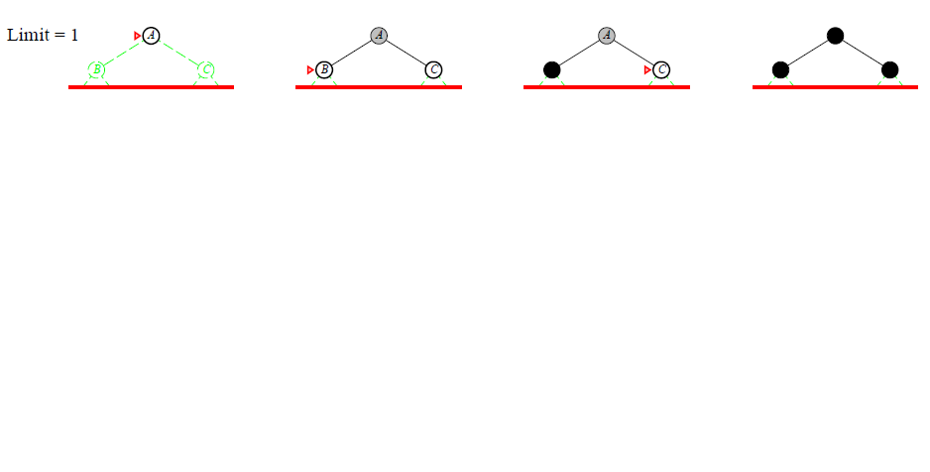
Iterative Deepening Search (IDS)

Slide 38
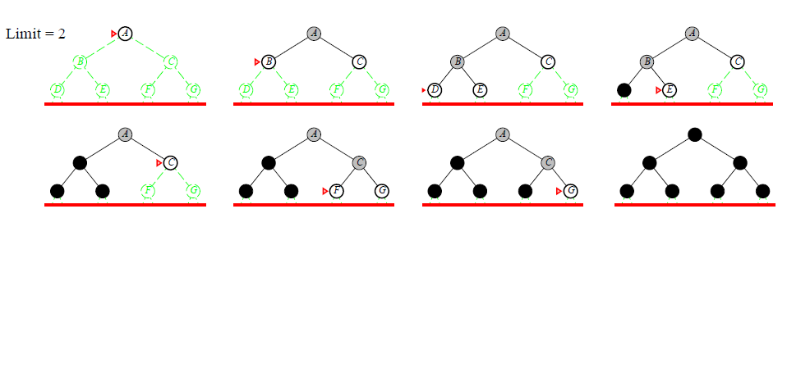
Iterative Deepening Search (IDS)

Slide 39
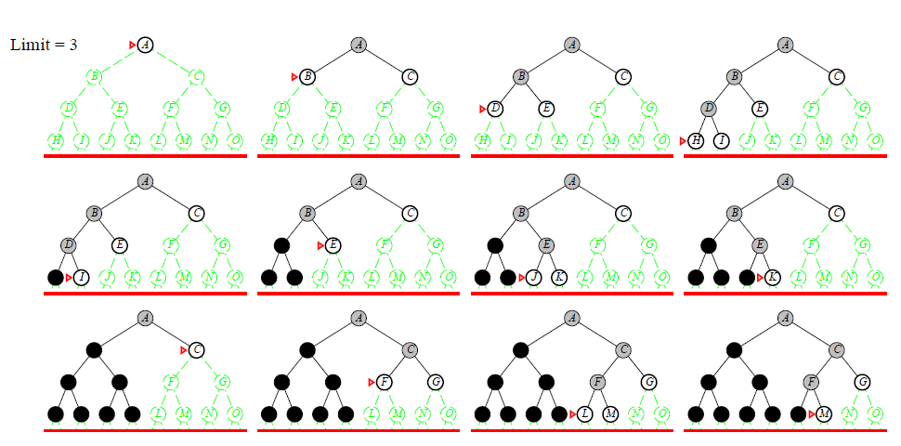
Iterative Deepening Search (IDS)

Slide 40
Informed Search Strategies
The general approach we consider is called best-first search
It expands the node n with the lowest evaluation cost f(n)
Remember the uniform cost search? What is the principle to expand the node?
Most best-first search algorithms include a component of f:
A heuristic function h(n): Estimated cost of the cheapest path from the state at node n to a goal state

Slide 41
Informed Search Strategies
Strategies:
(Greedy) Best First Search Algorithm
A* Algorithm

Slide 42
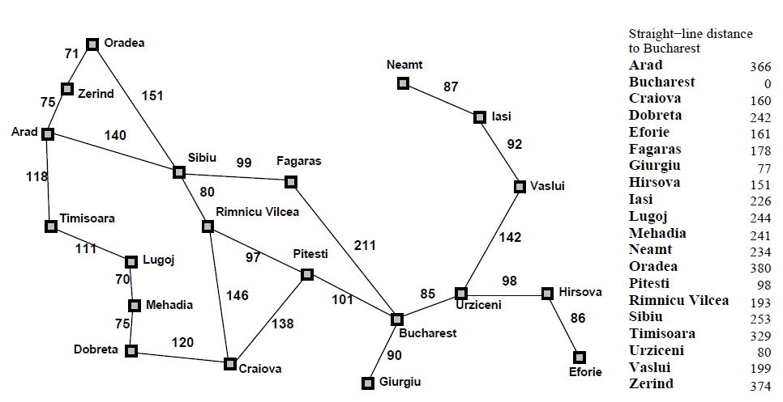
Romania with step costs in km
366

Slide 43
(Greedy) Best-First Search
Greedy best-first search tries to expand the node that is closest to the goal.
Thus, f(n) = h(n)
For example, in route-finding problems in Romania:
We use the straight line distance heuristic (h_{SLD})
h_{SLD}(In(Arad)) = 366
Denotes that the straight line distance from Arad to Bucharest is 366 km

Slide 44

(Greedy) Best-First Search

Slide 45
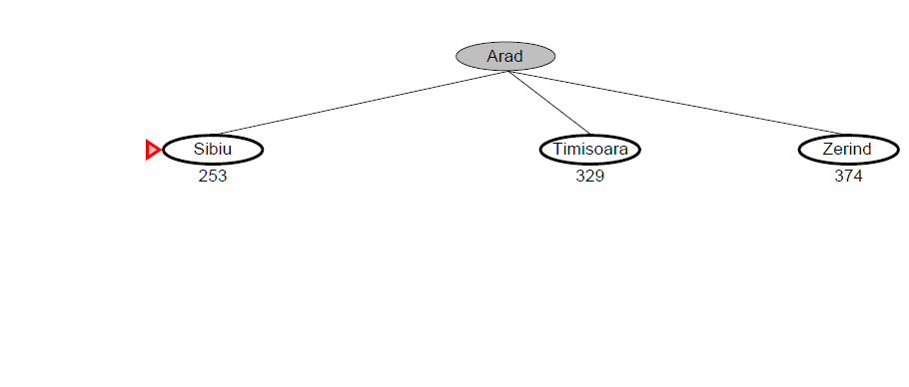
(Greedy) Best-First Search

Slide 46
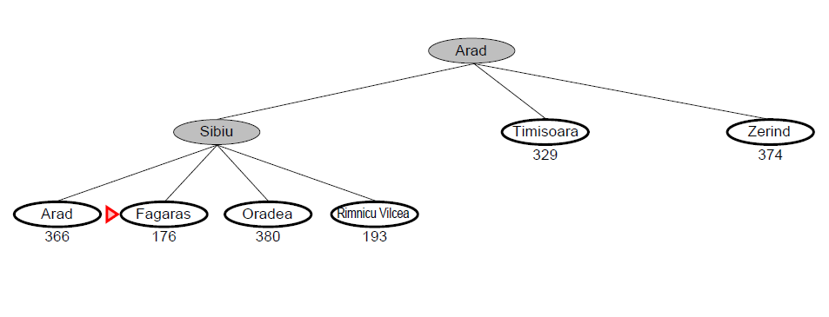
(Greedy) Best-First Search

Slide 47
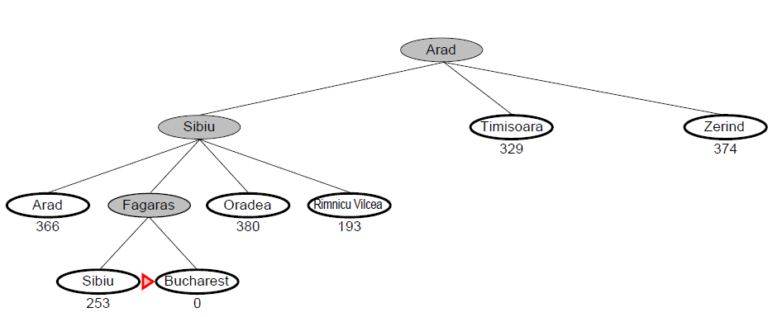
(Greedy) Best-First Search

Slide 48
A* Search
A* search tries to expand the node by combining the cost to reach the node (path cost) and the cost to get from the node to the goal.
Thus, f(n) = g(n) + h(n)
Again, the algorithm is identical to uniform-cost search except that A* use g(n) + h(n) instead of g(n)

Slide 49

A* Search

Slide 50
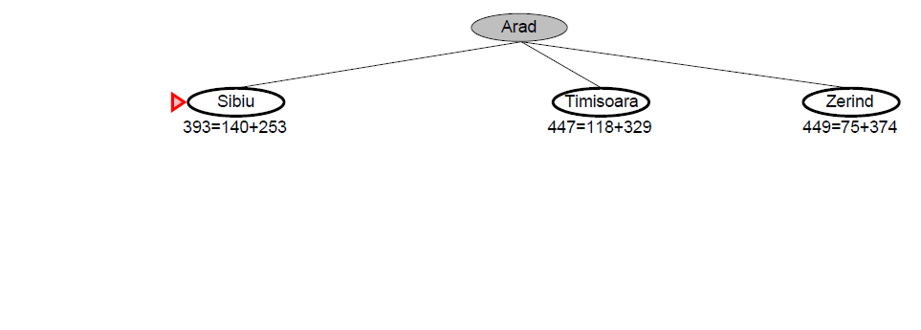
A* Search

Slide 51
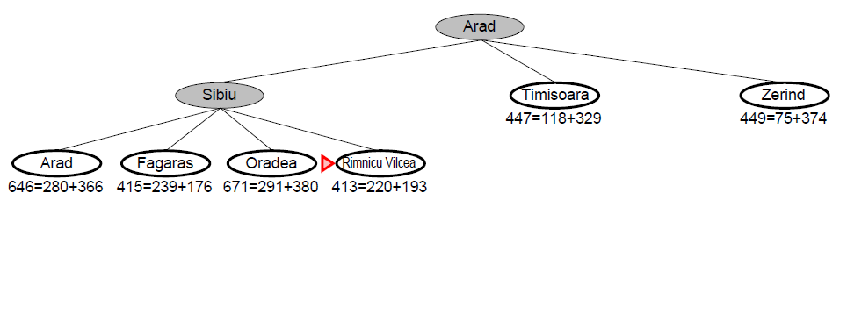
A* Search

Slide 52
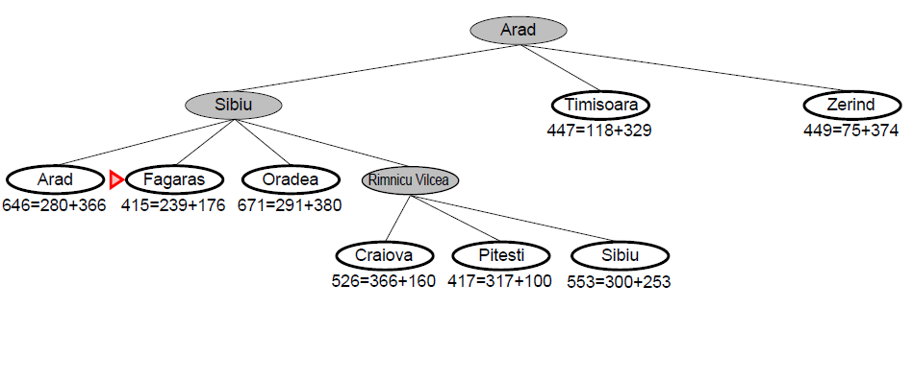
A* Search

Slide 53
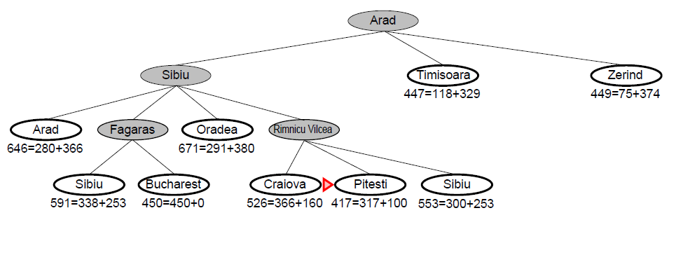
A* Search

Slide 54
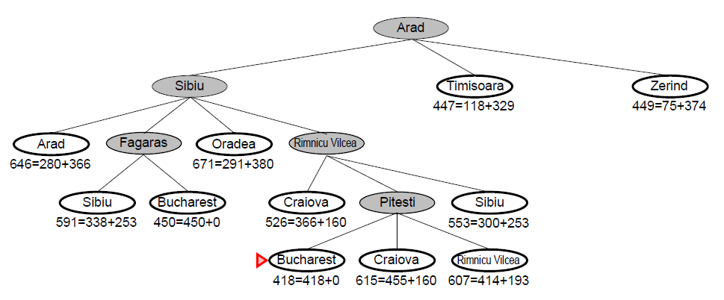
A* Search

Slide 55
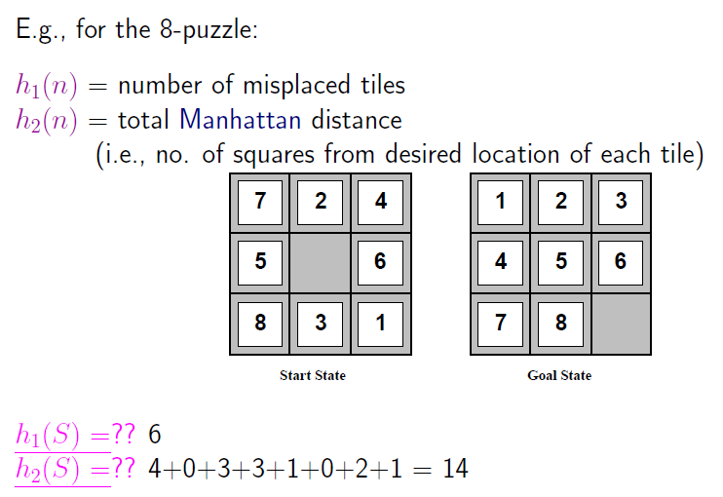
Heuristic Functions

Slide 56
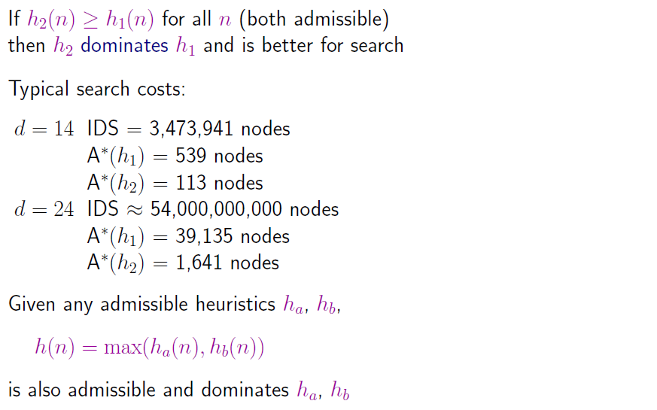
Heuristic Functions

Slide 57
References
Stuart Russell, Peter Norvig. 2020. Artificial Intelligence : A Modern Approach. Pearson Education. New Jersey. ISBN:9780132071482

Slide 58
Exercise

Slide 59
Exercise
Simulate the node expansion from start state (S) to reach goal state (G)
Using BFS, DFS, UCS
2.0
1.0
A
D
H
1.0
2.0
2.0
2.0
1.0
5.0
1.0
S
B
G
I
1.0
6.0
3.0
2.0
1.0
C
F
J
1.0
1.0

Slide 60
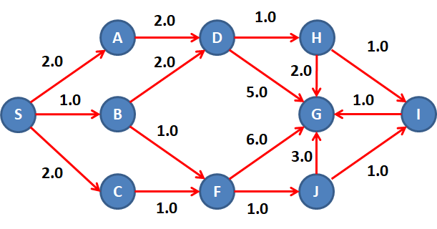
Exercise
Simulate the node expansion from start state (S) to reach goal state (G)
Using Greedy, A*
Given heuristic function:
h(A) = 8.0
h(B) = 9.0
h(C) = 7.0
h(D) = 5.0
h(F) = 4.0
h(H) = 2.0
h(G) = 0
h(J) = 3.0
h(I) = 1.0

